Slide 1
Introduction to SMART on FHIR
What is SMART on FHIR?
What Are the Benefits of SMART on FHIR?
Notes:
Welcome to our introduction to SMART on FHIR

Slide 2

Most of the Concepts We Will Discuss Are Trademarked
Notes:
Many of the concepts included in this presentation are trademarked including those shown here.

Slide 3
Most of the Information Provided Here Comes from Other Sources (including the following)
References:
Mandel, Josh, SMART on FHIR (from DevDays, Richmond, 2019) available at https://www.youtube.com/watch?v=N0PXAxBA-J8&t=112s
Cannon, Renee, SMART on FHIR: The Basics, available at https://www.youtube.com/watch?v=MMfe181tmwU
The Cerner SMART on FHIR Tutorial, available at https://engineering.cerner.com/smart-on-fhir-tutorial/
Notes:
Most of the information in this presentation comes from other sources including those shown here.

Slide 4
Introduction
This presentation gives an introduction to SMART on FHIR including
The goals of SMART on FHIR and the SMART on FHIR project and community
An overview of the architecture of SMART on FHIR with examples
A discussion of the benefits of using SMART on FHIR
Examples of existing SMART on FHIR applications and successes
Notes:
This presentation gives an introduction to SMART on FHIR including
The goals of SMART on FHIR and the SMART on FHIR project and community
An overview of the architecture of SMART on FHIR with examples
A discussion of the benefits of using SMART on FHIR
Examples of existing SMART on FHIR applications and successes

Slide 5
SMART on FHIR Mission Statement
The goal of the SMART on FHIR project is to provide a framework, software, and other tools to enable the seamless integration of software into existing mission critical systems commonly used by patients, clinicians, and support staff. This includes all aspects of software development and integration including authorization and authentication, User Experience (UX), data integration (using FHIR), and integration with other third-party tools and frameworks, etc. The SMART on FHIR implementation is a consistent, reliable, reusable, publicly available open source, common solution that improves patient outcomes by efficiently providing patients, clinicians, and support staff with information and resources needed when they are needed.
* Unofficial not yet adopted draft (this is what I think SMART is all about)
Notes:
The goal of the SMART on FHIR project is basically to provide an effective, efficient, consistent, reusable mechanism to integrate additional functionality into EMRs and other existing clinical tools.

Slide 6
What is SMART on FHIR?
SMART on FHIR is a technology that allows applications to be launched directly from an EMR (or standalone applications to fully integrate with and EMR). The SMART on FHIR framework deals with all of the details of authentication and authorization. The SMART on FHIR framework enables the application to fully communicate with the EMR using FHIR. This includes reading as well as writing data to the EMR. This allows developers to focus on the business logic of their specific applications and enables a write once, run anywhere environment (with the caveat that all standards, including this one, have flexibility that will require customization in some cases). The stability and consistency provided by the SMART on FHIR standard has led to the creation of a wealth of publicly available applications that can be accessed through the App Gallery at https://apps.smarthealthit.org/ and the Application Stores and Application Orchards of major vendors such as Cerner and Epic. The stability and consistency provided by SMART on FHIR has also led to the development of tools and frameworks that can be used by developers to automate and otherwise streamline and improve their applications and efforts. These tools and frameworks include UX frameworks such as the LForms framework that automates the rendering, reading, and writing of FHIR Questionnaire and QuestionnaireResponse data and the Clinical Quality Language that manages and makes computable the complexities of clinical quality measures and clinical decision support.
* Unofficial not yet adopted draft (this is what I think SMART is all about)
Notes:
Wow, that’s a lot of words, let’s pull out some key points.

Slide 7
What is SMART on FHIR: Key Points
What is SMART on FHIR?
SMART on FHIR is a technology that allows applications to be launched directly from an EMR (or standalone applications to fully integrate with and EMR).
SMART on FHIR provides a complete integration solution
The SMART on FHIR framework deals with all of the details of application integration so application developers can focus on the implementation of their specific business logic.
Write Once, Run Anywhere
SMART on FHIR enables a write once, run anywhere environment (with the caveat that all standards, including this one, have flexibility that will require customization in some cases).
A Wealth of Applications that Keeps Growing and Evolving
SMART on FHIR standard has led to the creation of a wealth of publicly available applications that can be accessed through the App Gallery at https://apps.smarthealthit.org/ and the Application Stores and Application Orchards of major vendors such as Cerner and Epic.
Integration With Other Third-party Frameworks
The stability and consistency provided by SMART on FHIR has also led to the development of tools and frameworks that can be used by developers to automate and otherwise streamline and improve their applications and efforts.
Notes:
Well, this is still a lot of words, but don’t worry if you don’t fully ingest all of this information, we will go into the details in subsequent slides
SMART on FHIR provides a complete integration solution that allows application developers to efficiently integrate new functionality into EMRs and other clinical applications
It provides a write once, run anywhere solution that provides enormous cost savings as well as reproducibility and consistency
SMART on FHIR’s success is reflected by the wealth of applications that are available at the SmartHealthIT App Gallery as well as at the application stores and orchards of major vendors such as Cerner and Epic
And SMART on FHIR allows for the integration of other third party frameworks that automate tedious tasks such as building web forms or implementing complex clinical quality measure queries and clinical decision support logic
Let’s dive into some of the details around all of this…

Slide 8
What is SMART on FHIR?
SMART on FHIR is the glue that connects an application to a clinical system
Notes:
SMART on FHIR is a well architected solution for system integration and data exchange
It uses an n-tier solution to maintain good separation of concerns between business logic (on the left), clinical systems and data (on the right), and integration (the SMART layer in the middle) with a well-defined data value objects model (FHIR)

Slide 9
Application Development Without SMART on FHIR
Multiple teams developing multiple implementations of the same specification that will be at least somewhat dissimilar.
Notes:
Without a common integration lay like SMART on FHIR separate implementation teams will implement the same specification to create different applications for different EMRs, Patient Portals, and so on.
Each individual implementation has a cost in resources
Each implementation has the potential to vary from the others based on the team’s interpretation of the specification

Slide 10
Application Development With SMART on FHIR
A single team can create a single solution that can be used across multiple EMRs, Patient Portals, etc., thereby creating an efficient and consistent solution
Notes:
With SMART on FHIR a single SMART on FHIR application can be built and deployed to multiple EMRs, Patient Portals, and other user facing applications

Slide 11
Integration With Third-party Tools and Frameworks Example: The HIV-CDS Implementation Guide
Uses Clinical Quality Language to Implement complex logic to implement CDC guidelines for HIV Testing
Uses Questionnaire FHIR resources that can be rendered, populated, and used to write QuestionnaireResponse FHIR resources back to the EMR using tools like Lforms
https://build.fhir.org/ig/cqframework/hiv-cds/

Slide 12
Why SMART
Advantages of a SMART on FHIR Solution
Users
App choice (substitutability)
Developers
Low barriers to entry (open standards, large community)
Single app can run in systems by different vendors
Single app can run in different contexts (e.g. EHR and Patient Portal)
A stable standard allows for integration with third-party frameworks and tools
Notes:
Users can select what applications they want to use and integrate into their workflow
Developers benefit from a pluggable architecture and access to a well defined API and associated frameworks
Cost, time to market, and consistency are improved by the ability to share a single application across multiple platforms

Slide 13
Why Smart: Bottom Line
Cost
Write once, run anywhere (theoretically/eventually)
Developers only need to learn one standard
With the caveat that SMART on FHIR applications and Implementation Guides can depend on a wide range of tools, APIs, and cutting edge (new and sparsely documented) technologies
With a standard such as SMART, APIs and other tools have been developed as frameworks that can be leveraged by developers of new SMART on FHIR applications, for example
Tools that render, read and write to FHIR Questionnaire resources such as LForms
Tools that manage complex quality measures and clinical decision support such as the Clinical Quality Language (CQL)
Consistency
Write once by definition gives us a consistent implementation over multiple implementations of the same logic
Clinical guidelines can be implemented in a single place and made available to all clinicians with access to a SMART on FHIR compatible system
Modifications and Updates can be made in a single place
Notes:
SMART on FHIR provides tremendous cost and consistency benefits

Slide 14
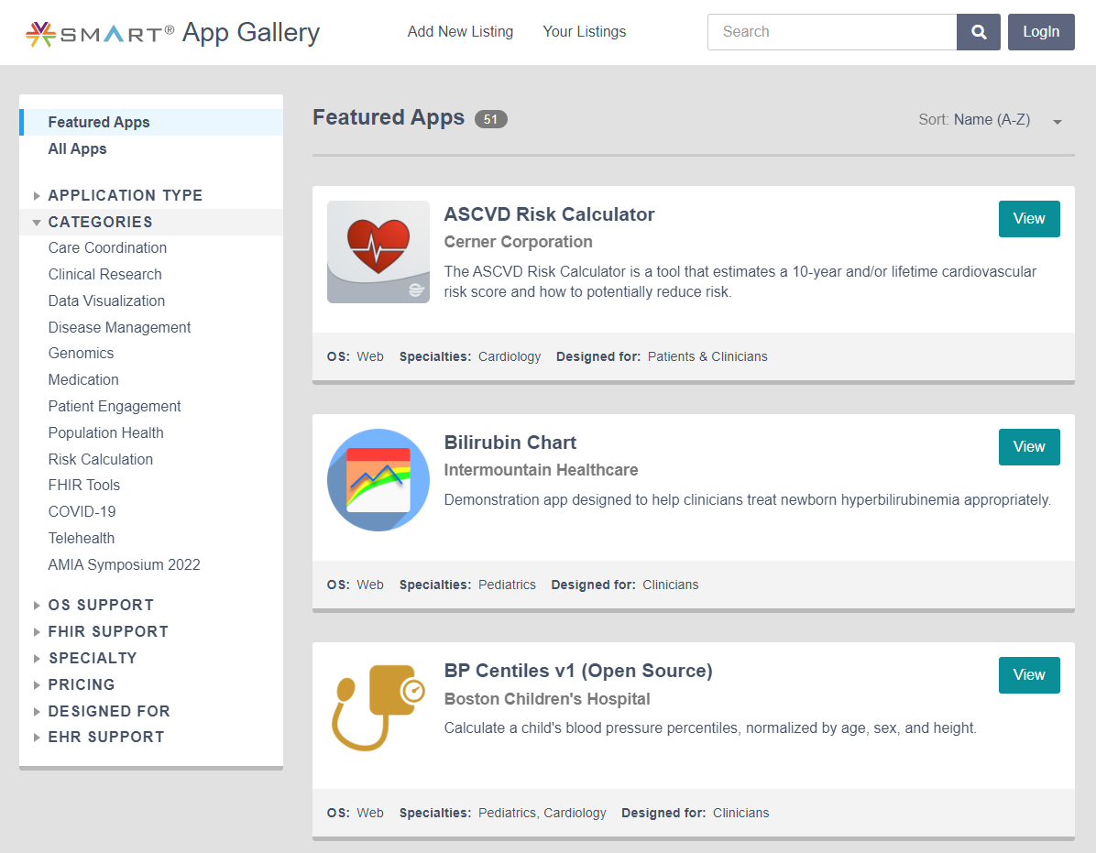
Reuse
SMART App Gallery
Developers publish Applications and information about applications to apps.smarthealthid.org
https://apps.smarthealthit.org/
Integration into EMR Application Stores and Application Orchards (e.g. Cerner, Epic, etc.)
Proven solutions that work with the specific vendor implementation

Slide 15


